Slide 1
Stock Forecaster
VINAY SHIVAKUMAR
NEHA DESAI
SIVARAMHARESH SIVA
VINAY PANJABI
KRISHA PAULA OLANDAY
JONATHAN HAAS

Slide 2
So what’s the purpose of this product?

Slide 3
Purpose #1:Well-Rounded Investor
Making individual investors well-informed of all aspects of the company’s stock:
Stock Price: Prediction graph
News: Current links about the company
Critics: Links to external sources

Slide 4
Purpose#2: Simplicity
No need for investor to look at numerous sites!
No clutter on portfolios
Few clicks to receive all relevant information
Simplicity leads to efficiency

Slide 5
Purpose#3 – Be Informative
Provide predictions for the sole purpose of information
We leave trading options to user to see potential outcomes
Many users have different intentions so we take that into account

Slide 6
Who Is This Product Primarily For?
Individual Investor –
Someone who invests without team guidance
Someone whose primary source of income isn’t through trading
Anyone else interested in stocks
Enough information for interested folk

Slide 7
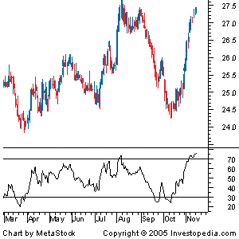
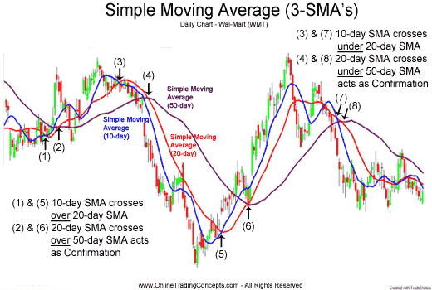
Moving Average & RSI

Slide 8
Plan of Course for the Future
Database Subgroup:
Will populate database of the information from Yahoo API to Rails
Create more tables for different stocks
Include trading day (date) for each table
UI Design and Implementation Subgroup:
Complete Charting Implementation
Moving Average & RSI
Incorporate other news & information
Support profiles/portfolio
Algorithm Subgroup:
Implement RSI
Add similar unit tests for this algorithm
Eventually overlay both the RSI and moving average model if time permits

